Slide 1

Smoke Monitor
Serverless computing 2021
Prof Vittorio Scarano.

Slide 2


Outline
Brief Introduction of Problem Area
Purpose of the Project
Services/Libraries of the tool Used
Implementation
Applications

Slide 3
Brief Introduction of Problem Area
Inhaling gases such as, propane , Methane at high concentration even for a short time can cause fainting and/or death. Inhaling of LPG vapor can cause irritation in nose and throat, headache and nausea, vomiting, dizziness and loss of consciousness. These Gases can cause fainting and choking in closed or poorly ventilated environment
During a home fire, there's an increased level of carbon monoxide and carbon dioxide as well as damaging levels of chemical and thermal irritants. These irritants can permanently damage a person's or animal's respiratory system and cause death

Slide 4
Purpose of the Project
Smoke Detectors are very useful in detecting smoke or fire (GAS) in buildings, and so are the important safety parameters. By using Smoke sensor one can get notify in mean time which can cause save from any kind of incident related to both Health and Wealth

Slide 5
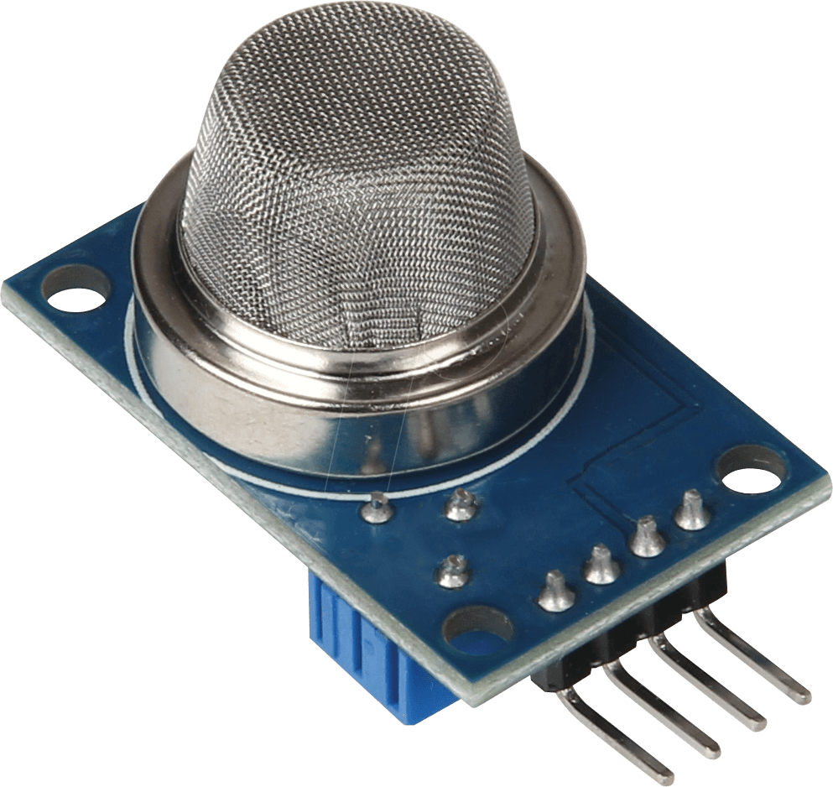
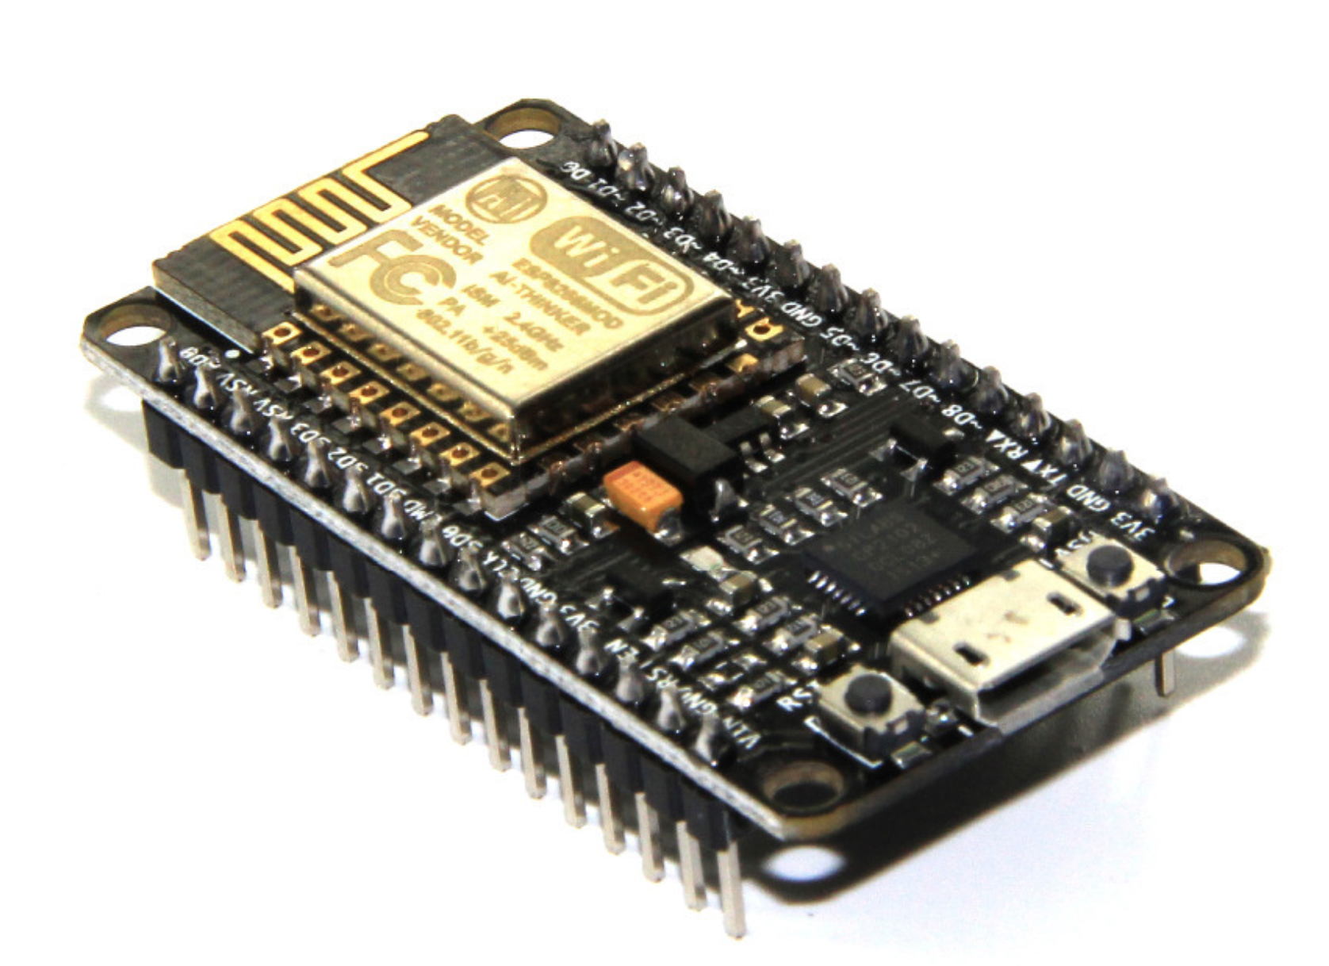

Services of the tool Used
Mq2 Sensor
Node Mcu
Nuclio
he Gas Sensor(MQ2) module is useful for gas leakage detecting(in home and industry). It can detectH2, LPG, CH4, CO, Alcohol, Smoke, Propane. Based on its fast response time. Measurements can be taken as soon as possible. Also the sensitivity can be adjusted by the potentiometer
NodeMCU (Node MicroController Unit) is an open source software and hardware development environment that is built around a very inexpensive System-on-a-Chip (SoC) called the ESP8266.
Nuclio is an open source and managed serverless platform used to minimize development and maintenance overhead and automate the deployment of data-science based applications

Slide 6



Services of the tool Used
RabbitMq
Arduino
MQTIZER
RabbitMQ is a messaging broker - an intermediary for messaging. It gives your applications a common platform to send and receive messages, and your messages a safe place to live until received.
The Arduino Integrated Development Environment - or Arduino Software (IDE) - contains a text editor for writing code, a message area, a text console, a toolbar with buttons for common functions and a series of menus. It connects to the Arduino and Genuino hardware to upload programs and communicate with them.
MQTIZER is a mobile MQTT client that can connect to any broker which shares the network with your phone, and to any broker on the cloud as well

Slide 7



Libraries/Services of the tool Used
Pubsub Client
Docker
ESP8266WiFi
Docker is an open source containerization platform. It enables developers to package applications into containers—standardized executable components combining application source code with the operating system (OS) libraries and dependencies required to run that code in any environment.
The ESP8266WiFi library provides a wide collection of C++ methods (functions) and properties to configure and operate an ESP8266 module in station and / or soft access point mode.
A client library for MQTT messaging. MQTT is a lightweight messaging protocol ideal for small devices. This library allows you to send and receive MQTT messages.

Slide 8
Implementation
Ubuntu
Docker
Nuclio
RabitMQ
Arduino IDE
The first step was to install Ubuntu on a Virtual Machine
Second step was to install docker on ubuntu
Then install Nuclio on Ubuntu using Docker
After installing Nuclio. I install RabitMQ on Ubuntu using Docker
Download arduino on main operating System

Slide 9
Implementation
Connecting Sensor with NodeMCu
Uploading Code on arduino
Deploying Function On Nuclio
Queues RabitMQ
MQTIZER
Connect Mq2 sensor with NodeMcu using Jumper wire
After installing ESpwifi8266 and pubsubclient library than upload the code on NodeMcu
Implementing the function on Nuclio . setting the Triggers and than Deploying
The function deployed on Nuclio will create Queues on RabitMQ
Use Mqtizer to check Mqtt messages on Mobile Application

Slide 10
Applications
Fire and Gas Detection and Alarm Systems
The response of beam smoke detectors is generally less sensitive to the type and color of smoke. Therefore, a beam smoke detector may be well suited to applications unsuitable for point optical smoke detectors, such as applications where the anticipated fire would produce black smoke. Beam smoke detectors do, however, require visible smoke and therefore may not be as sensitive as ion detectors in some applications.
Emergency Management
Smoke detectors are particularly useful in those situations where the fire is likely to generate a substantial amount of smoke before temperature changes are sufficient to actuate a heat detection system and before a fire eye will detect a flame. Smoke detectors use a photoelectric beam between a receiving element and light source. If smoke obscures the beam an alarm is sounded. There are also refraction-type models that measure the light changes that occur within the instrument when smoke particles enter it.

Slide 11
Thank you!
s.khan6@studenti.unisa.it

